Slide 1


CAPSTONE PROJECT
smart campus energy consumption analysis using power bi
PRESENTED BY: SHRUTHI KANDUKURI
Student Name: shruthi Kandukuri
College Name: Vaagdevi college of engineering
Department: Master of business administration (mba)
Email ID:Iamshruthi12@GMAIL.COM

Slide 2
OUTLINE:
Introduction to the problem
Problem statement
Proposed solution
System Development Approach
Tools used
Dataset Example
Bar Chart, Line Chart, Pie Chart, Stacked Column Chart, Area Chart, and KPI .
Results
Conclusion
Future Scope
References

Slide 3
Problem Statement:
Electricity consumption in college campuses is usually very high because many facilities operate throughout the day. Classrooms, laboratories, hostels, libraries, and administration offices all require electricity for lighting, computers, air conditioning, and other equipment.
However, in many institutions there is no proper system to analyze how electricity is being used across different buildings. As a result, energy may be wasted without anyone realizing it.
Without proper monitoring, it becomes difficult for administrators to understand which areas consume the most electricity and during which time periods.
Therefore, analyzing energy consumption using data visualization tools can help institutions manage electricity usage more efficiently and reduce unnecessary energy costs.

Slide 4
Proposed Solution:
The proposed solution is to analyze campus electricity consumption using interactive dashboards created in Microsoft Power BI.
Energy consumption data from different campus buildings is collected and organized in a dataset. The dashboard then visualizes this data to show patterns and trends in electricity usage.
The analysis focuses on building such as classrooms, laboratories, hostels, libraries, and administrative offices.
By visualizing the data through charts and graphs, administrators can clearly see which buildings consume the most electricity and during which months the consumption is highest.
This information can help institutions take steps to reduce energy waste and improve energy management.

Slide 5
System development Approach:
The project follows a simple data analysis process:
First, electricity consumption data is collected from campus facilities. The dataset contains information about the building name, month and total electricity usage.
Next, the data is reviewed and cleaned to make sure there are no missing or incorrect values.
After preparing the dataset, it is imported into Power BI where different visualizations are created to analyze the energy usage.
Charts and graphs are then used to identify patterns, trends, and areas with high electricity consumption.

Slide 6
TOOLS USEd
This project uses a few simple tools for data analysis and visualization.
Microsoft Excel
Excel is used to store and organize the dataset containing electricity consumption data.
Microsoft Power BI
Power BI is used to create dashboards and visualizations that make it easier to understand the data.
Microsoft PowerPoint
PowerPoint is used to present the project results and findings.

Slide 7
Dataset Example
The dataset used in this project contains information about electricity usage in different campus buildings.
Dataset: This dataset allows us to analyze how electricity consumption varies across different facilities.
Building | Month | Electricity Usage(kWh)
Classroom block | January | 1200
Library | January | 800
Hostel | January | 1500
Laboratory | January | 1000
Admin Office | January | 600

Slide 8
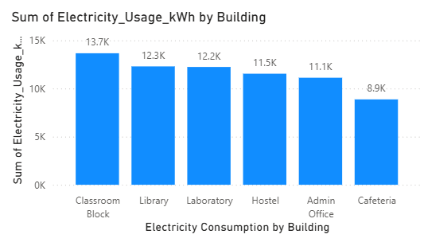
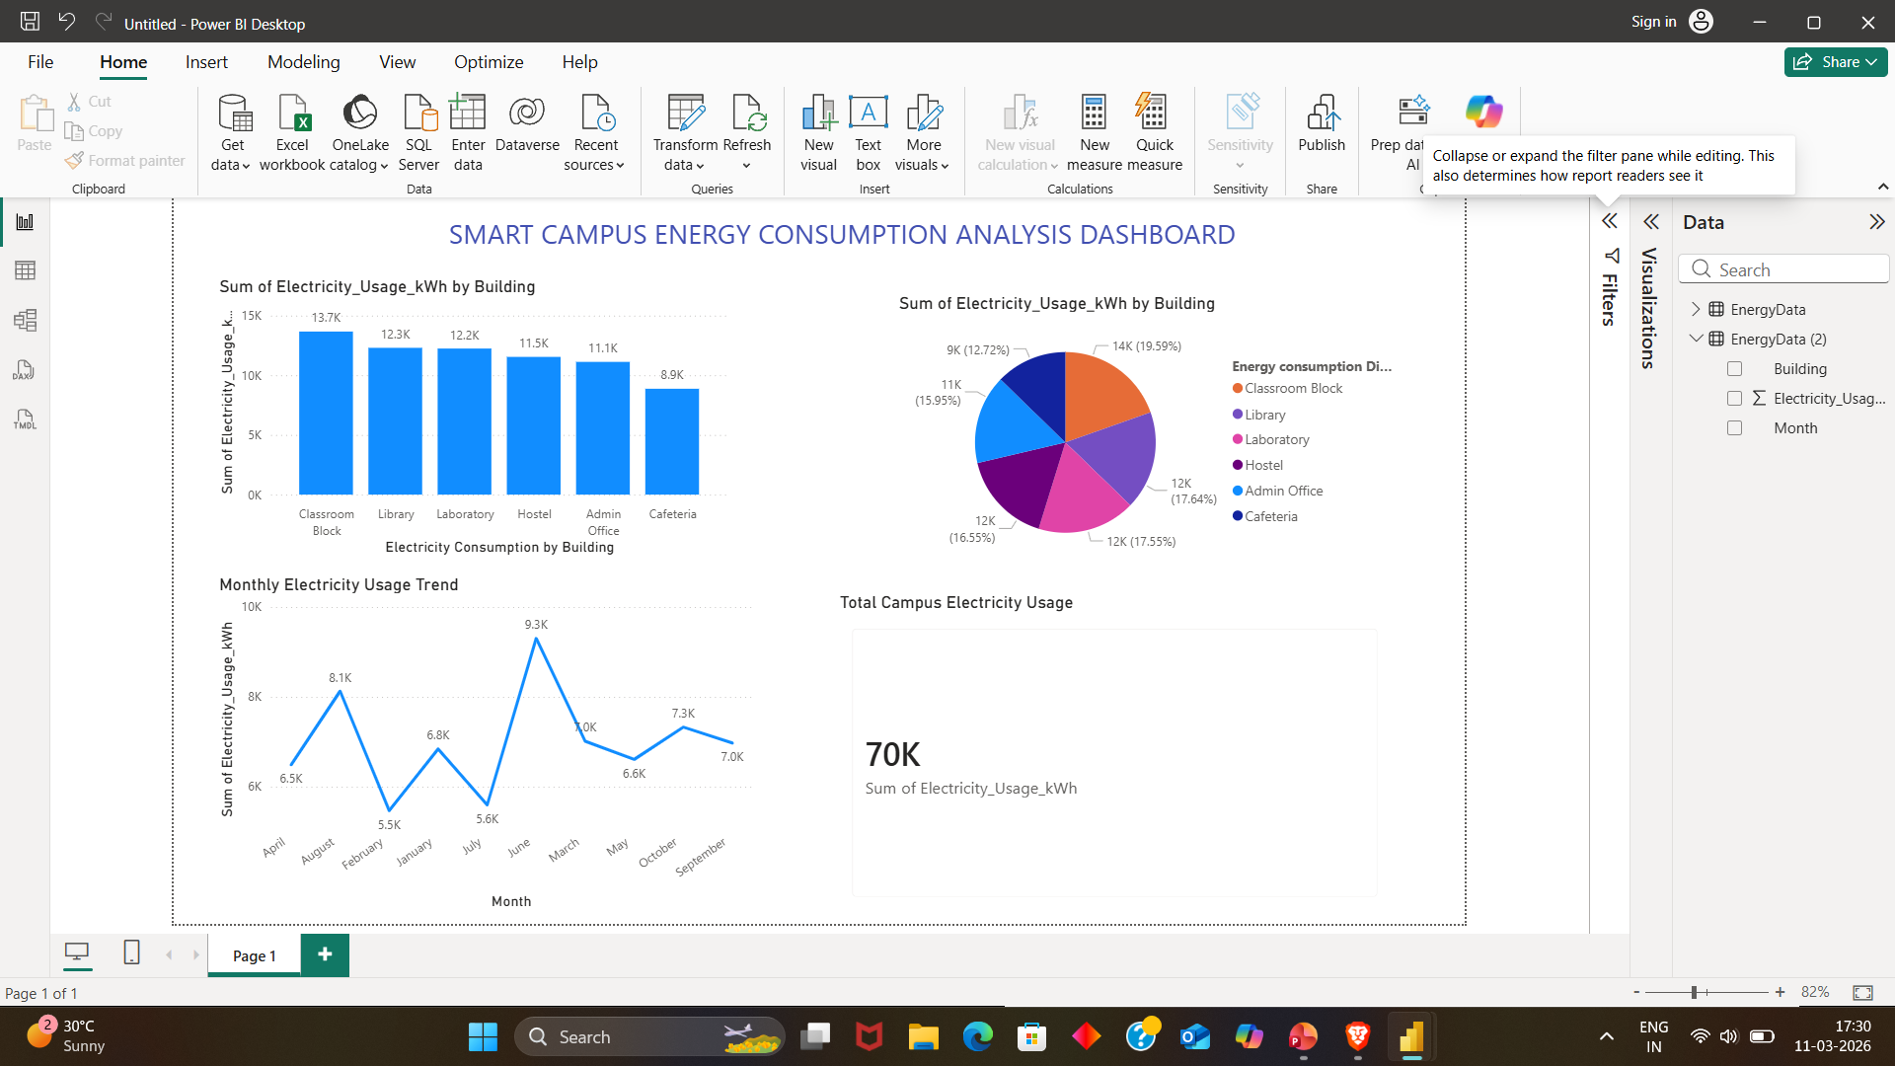
CHART 1: BAR CHART
This chart shows the comparison of electricity usage across buildings.
Helps identify the building with highest energy consumption.
The Hostel and laboratory consume higher electricity due to longer operating hours and equipment usage, while administrative offices consume relatively less energy.

Slide 9
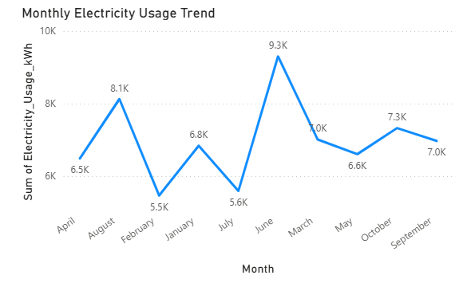
CHART 2: LINE CHART
This line chart illustrates the monthly electricity usage trend across campus buildings. It helps identify fluctuations in energy consumption and highlights months where electricity demand increases due to higher campus activities.

Slide 10
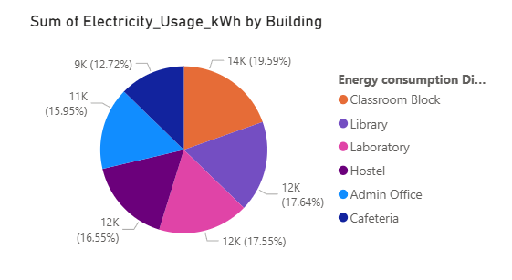
Chart 3: pie chart
The pie chart represents the percentage distribution of electricity usage among campus buildings. It provides a clear view of which buildings contribute the most to the total energy consumption.

Slide 11
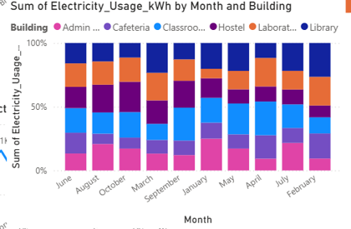
Chart 4:stacked column chart
This chart shows how electricity consumption varies across different buildings each month. It helps identify buildings with consistently high energy usage.

Slide 12
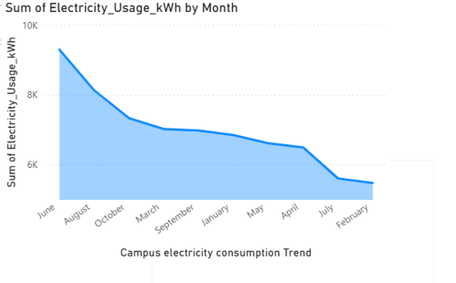
Chart 5: AREA CHART
The area chart visualizes changes in electricity consumption over time, helping identify seasonal patterns and peak energy demand periods.

Slide 13
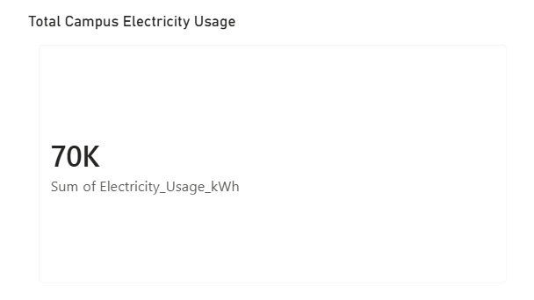
Chart 6: kpi card
The KPI card displays the total electricity consumption across all campus buildings. It provides a quick overview of overall energy usage and helps administrators monitor total electricity demand.

Slide 14
RESULTS:
The total electricity consumption across all campus buildings is approximately 70,000 kWh.
Classroom blocks consume the highest electricity, mainly due to continuous usage of lighting, computers, and air-conditioning during academic hours.
Libraries and laboratories also show high energy usage because of computers, lab equipment, and longer operating hours.
Administrative offices consume comparatively less electricity since they operate only during limited working hours.
Monthly electricity usage shows variations depending on campus activities and seasonal conditions.
Electricity consumption tends to increase during months with higher student presence and increased equipment usage.
Overall Insight:
The dashboard helps visualize energy consumption patterns across buildings and months, making it easier to identify high-usage areas.

Slide 15
CONCLUSION
This project demonstrates how data visualization and business intelligence tools can help analyze electricity consumption patterns within a campus environment.
By using Microsoft Power BI, large datasets can be transformed into meaningful dashboards that highlight energy usage trends across buildings and time periods.
The analysis clearly shows that different campus facilities contribute differently to total electricity consumption. Buildings such as classrooms, laboratories, and hostels have higher electricity demands due to continuous operational activities and equipment usage.
With the help of visual dashboards, campus administrators can easily monitor electricity usage, identify areas of high consumption, and make informed decisions regarding energy management.
Overall, the project highlights the importance of data-driven decision making in improving energy efficiency and reducing unnecessary electricity consumption.

Slide 16
FUTURE SCOPE
There are several opportunities to improve and expand this project in the future.
Possible enhancements include:
Integration with real-time electricity monitoring systems to track energy consumption automatically.
Use of Internet of Things(IoT) sensors to collect real-time electricity usage data from different campus buildings.
Implementation of predictive analytics models to forecast future electricity demand.
Development of automated alerts when electricity usage exceeds a predefined threshold.
Expansion of the system to monitor energy usage across multiple campuses or institutions.
Integration with renewable energy management systems such as solar power monitoring.
These improvements can help institutions build smarter and more sustainable energy management systems.

Slide 17
REFERENCES
Software and Tools
Microsoft Power BI: Official documentation and tutorials used for creating dashboards, visualizations, and data analysis.
Microsoft Excel: Used for organizing and preparing the electricity consumption dataset before importing it into Power BI.
Learning Resources
Microsoft Learn: Learning materials and tutorials on data visualization and Power BI dashboard development.
Microsoft Power BI Documentation: Used to understand chart creation, KPI cards, filters, and dashboards design.
Dataset source
Sample electricity usage dataset created for educational purposes to demonstrate energy consumption analysis across campus buildings and months.
Research and concepts
Research articles and online resources related to energy consumption monitoring and smart campus management.
Articles on business intelligence and data visualization techniques used for analyzing large datasets.
GITHUB LINK:

Slide 18
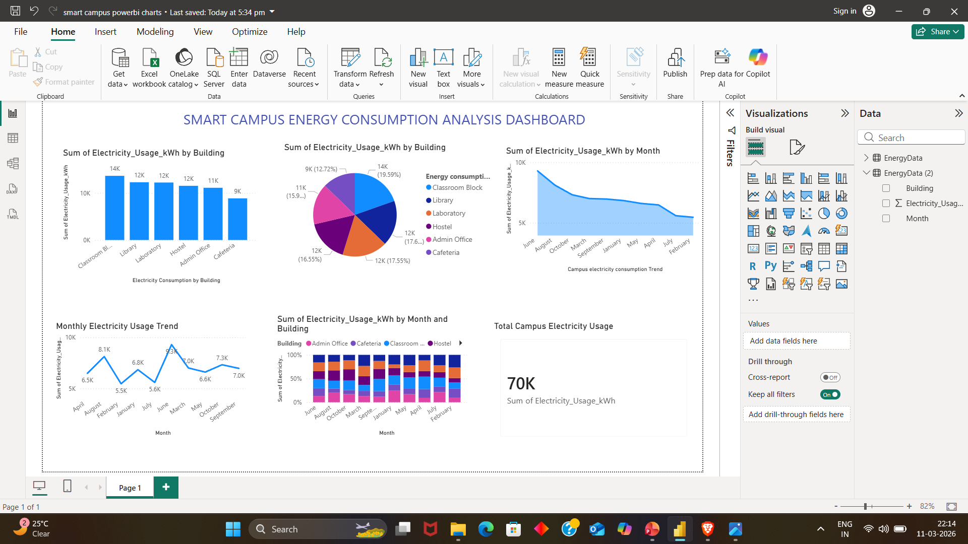
DASHBOARD OVERVIEW
This slide presents the Power BI dashboard created for analyzing campus electricity consumption. The dashboard includes multiple visualizations such as bar chart, line chart, pie chart, stacked column, area chart, and KPI indicators to monitor energy usage across campus buildings and months.

Slide 19
Thank You

